Slide 2
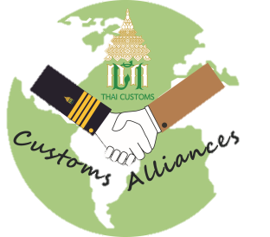
CA
พันธมิตรศุลกากร
CUSTOMS ALLIANCES
Background & Principle
Thai Customs have an intention to create more fairness, transparency and efficiency by initiating the collaboration with private sector as our partner and providing the communication channel directly between Thai Customs and private sector in order to coordinate for the purpose of solving problems in Customs related matters.
Partner
Benefits
There will be Account Officer (AO) for partners. The problems would be solved directly and correctly in a timely manner.
Time saving and cost reduction.
Create more transparency and accountability.
www.customs.go.th
Application
Apply via the Website :
By using company TAX ID number
Contact Person
Mr. Pakorn Tonmaneewattana : 063-904-2492
Ms. Kittima Paseetaweekeat : 063-904-2493
Dr. Thee Jitpitaklert : 063-904-2494
Ms. Duangkamon Khonpongpaiboon : 063-904-2518
e-mail : ca.teamcustomsth@gmail.com
Website : www.customs.go.th

Slide 3
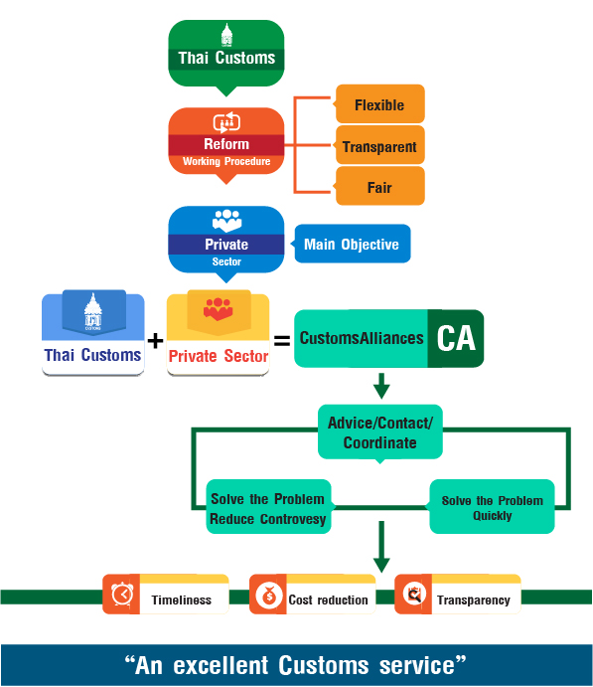
CA
พันธมิตรศุลกากร
CUSTOMS ALLIANCES

Slide 4
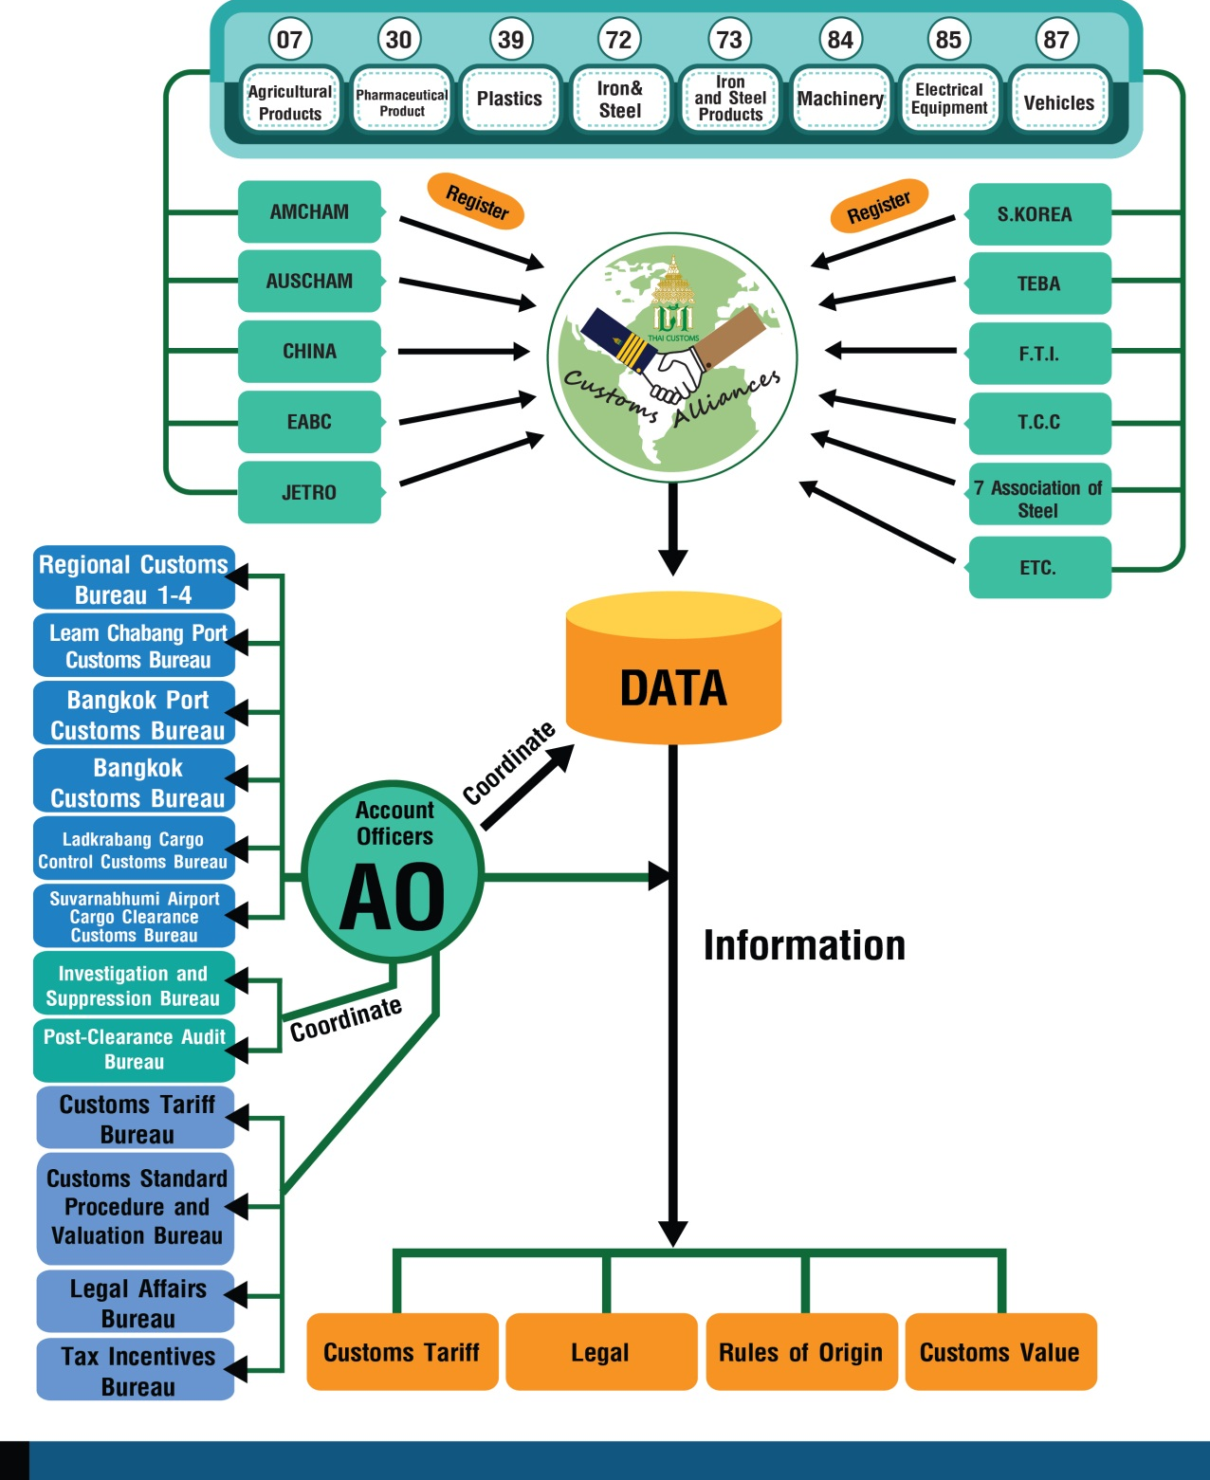
CA
พันธมิตรศุลกากร
CUSTOMS ALLIANCES

Slide 5
CA
พันธมิตรศุลกากร
CUSTOMS ALLIANCES
Registration

Slide 6
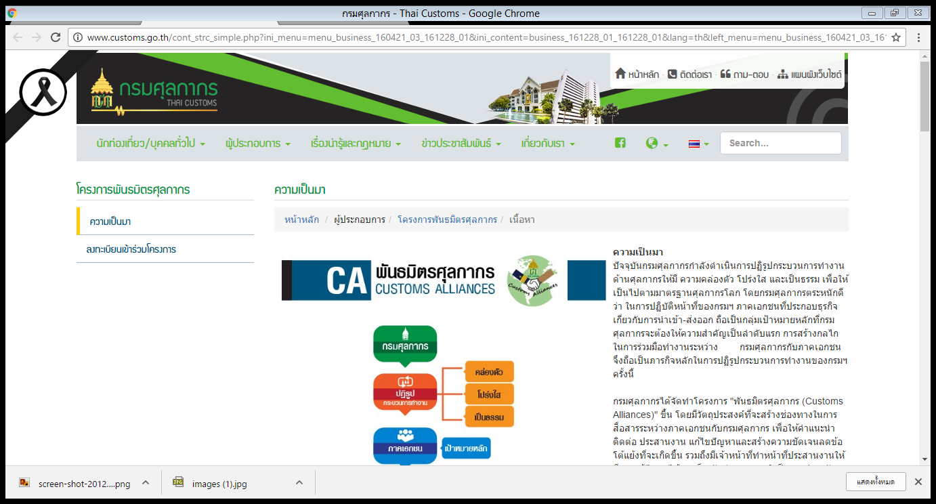
CA
พันธมิตรศุลกากร
CUSTOMS ALLIANCES
Registration

Slide 7
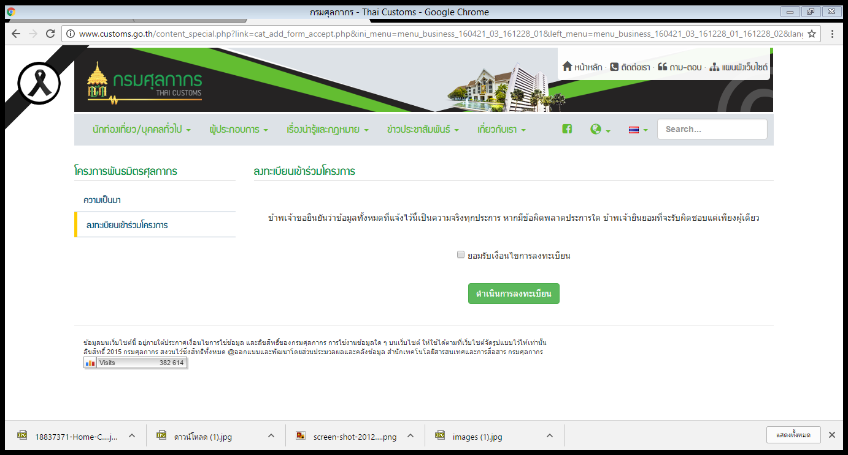
CA
พันธมิตรศุลกากร
CUSTOMS ALLIANCES
Registration
วิธีการสมัครสมาชิก

Slide 8
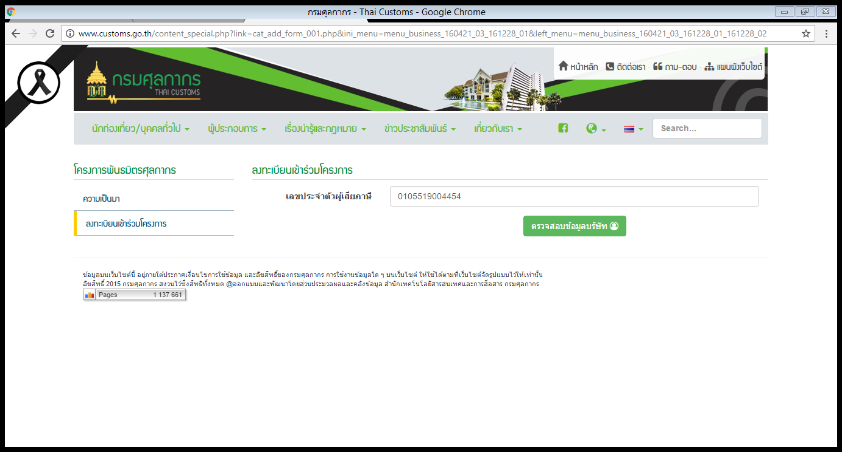
CA
พันธมิตรศุลกากร
CUSTOMS ALLIANCES
Registration

Slide 9
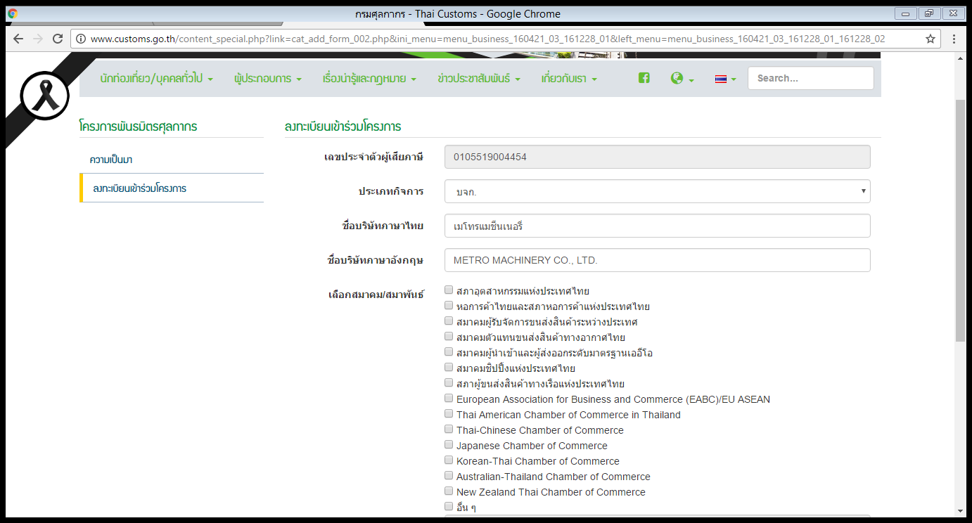
CA
พันธมิตรศุลกากร
CUSTOMS ALLIANCES
Registration

Slide 10
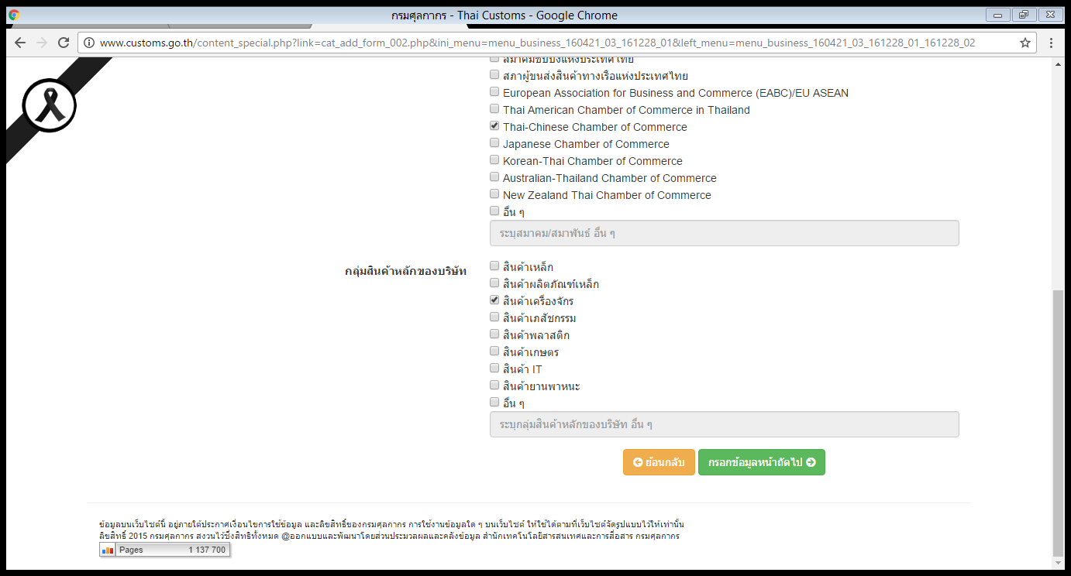
CA
พันธมิตรศุลกากร
CUSTOMS ALLIANCES
Registration

Slide 11
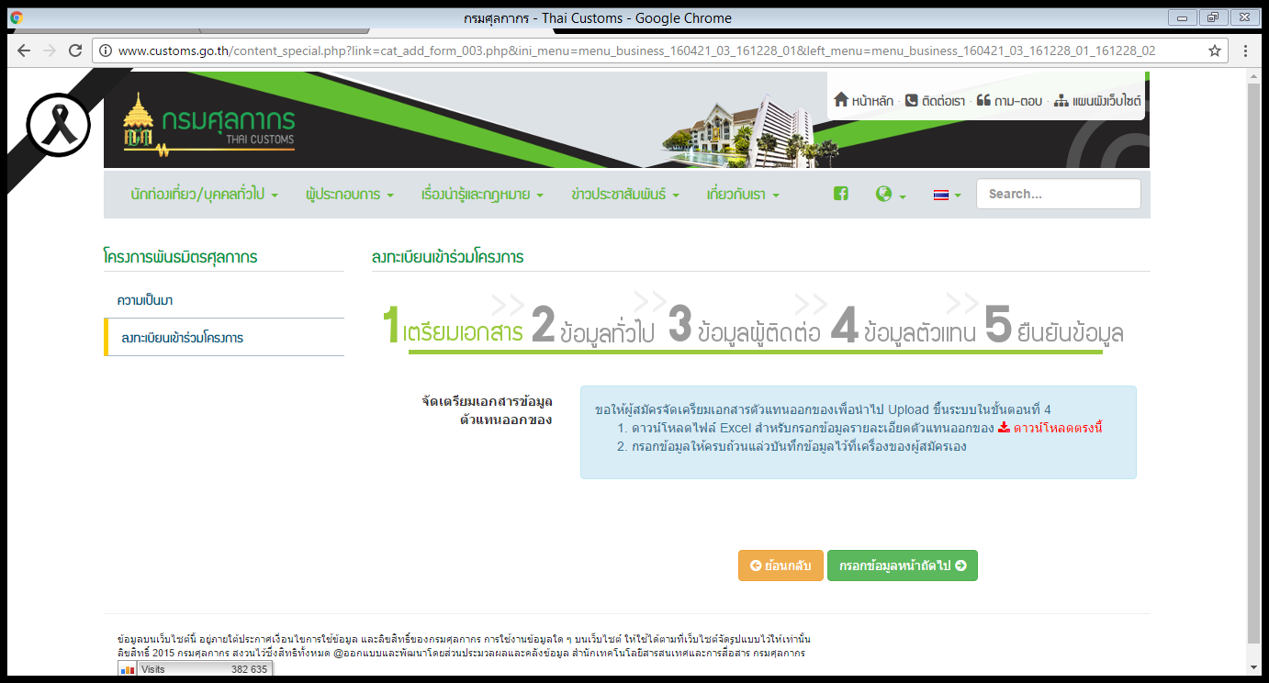
CA
พันธมิตรศุลกากร
CUSTOMS ALLIANCES
Registration

Slide 12
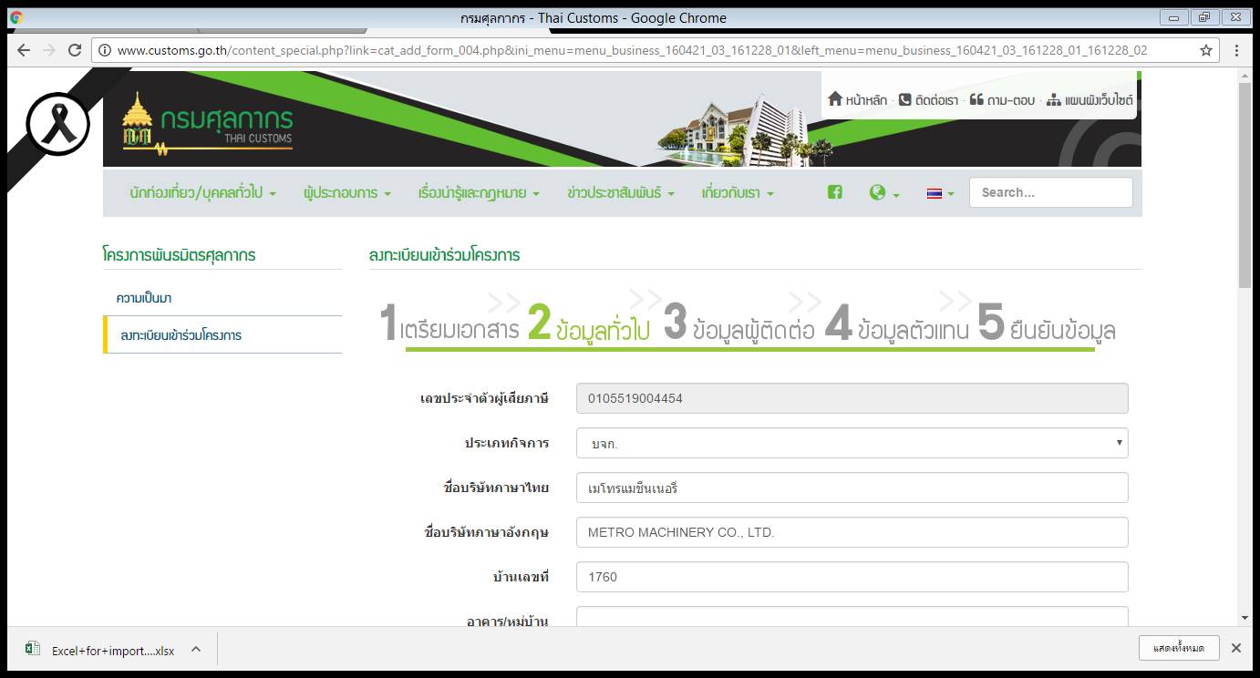
CA
พันธมิตรศุลกากร
CUSTOMS ALLIANCES
Registration

Slide 13
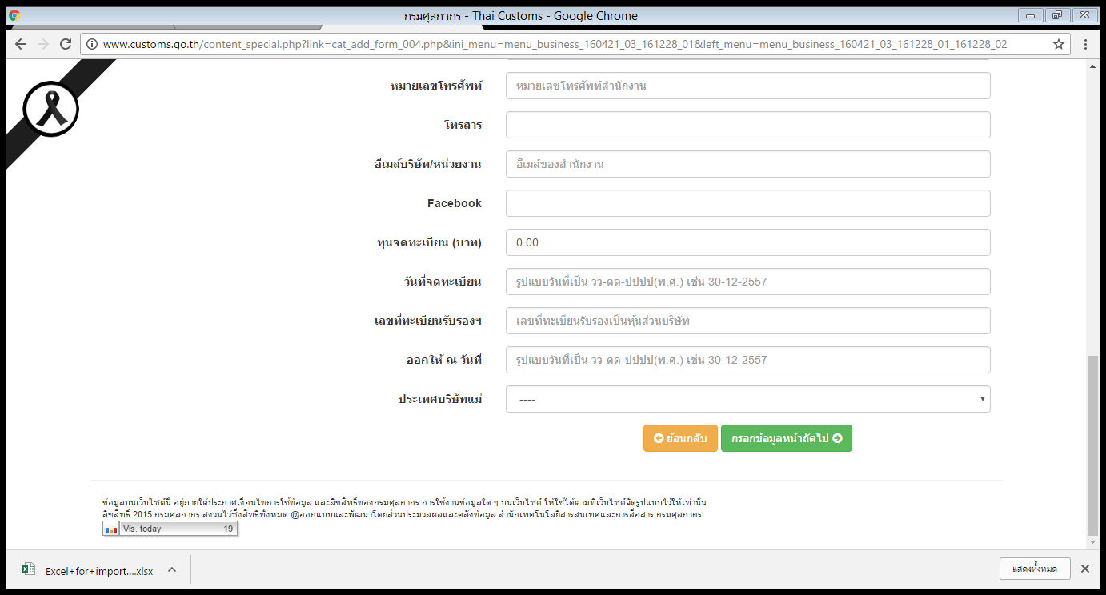
CA
พันธมิตรศุลกากร
CUSTOMS ALLIANCES
Registration

Slide 14
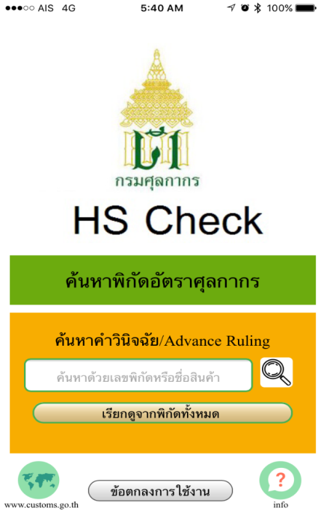
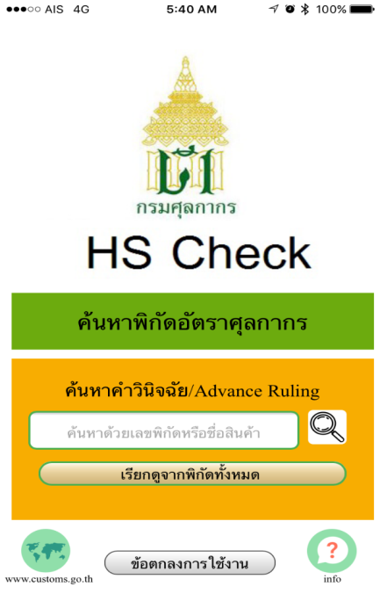
HS
HS
Check
หน้าจอหลัก

Slide 15
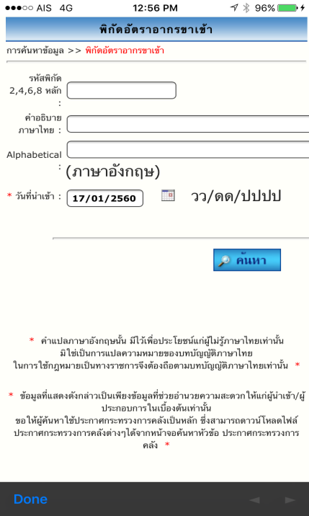
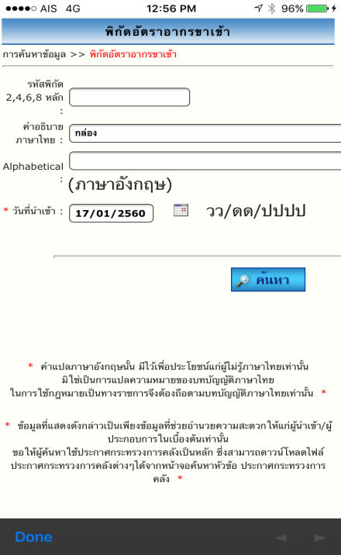
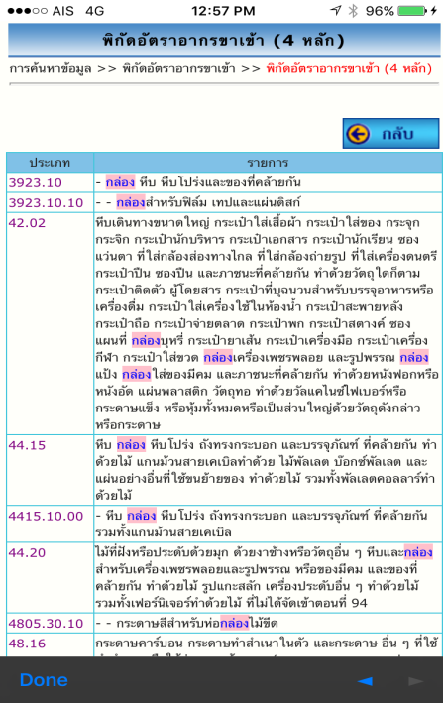
HS
HS
Check

Slide 16
Customs 4.0
1
2
3
4
Customs
Integrity
NSW
ASW
MRA of
AEOs
Moblie App.
Reinforce the Good Governance and organization image. Emphasize the transparency. The Customs Alliances fosters the operation with stakeholders and collaborate in action and inspection.
Increase efficiency of
trade facilitation.
Increase Thailand’s competitiveness
Provide security to the supply chain by exchanging tax incentives between internationally Authorized Economic Operators.
Mobile App, tariff, valuation, IPR. Develop information searching channel to Customs operations in more convenient way.
5
6
7
8
Advance
Ruling
Pre-arrival
Processing System
e-Payment
e-Lock
Develop services on Advance Ruling for tariff, Valuation and Rules of Origin in a fast & convenient way.
Increase efficiency of trade facilitation and update Customs procedures with Pre-arrival Processing System
Expand duty payment channels to be more convenient.
Increase the efficiency of customs control by e-lock system with transited goods.
เพิ่มช่องทางการชำระภาษี
ที่สะดวกรวดเร็วมากขึ้น
10
9
10
Eastern
Economic
Corridor
11
12
Voluntary
Audit Program
Adjust the Clearance Process
ASEAN
Gateway
Voluntary Audit Program. To audit tax payment for operators.
Adjust the clearance process for import goods.
Support the government’s policy by adjust and develop the efficiency of the tax Incentives.
Promote Thailand’s trade connectivity to ASEAN by developing the system and Customs procedures.
เพิ่มช่องทางการชำระภาษี
ที่สะดวกรวดเร็วมากขึ้น

