Slide 1
GLOBAL AND REGIONAL TRADE LANDSCAPE
Wayne Williams, CFO

Slide 2

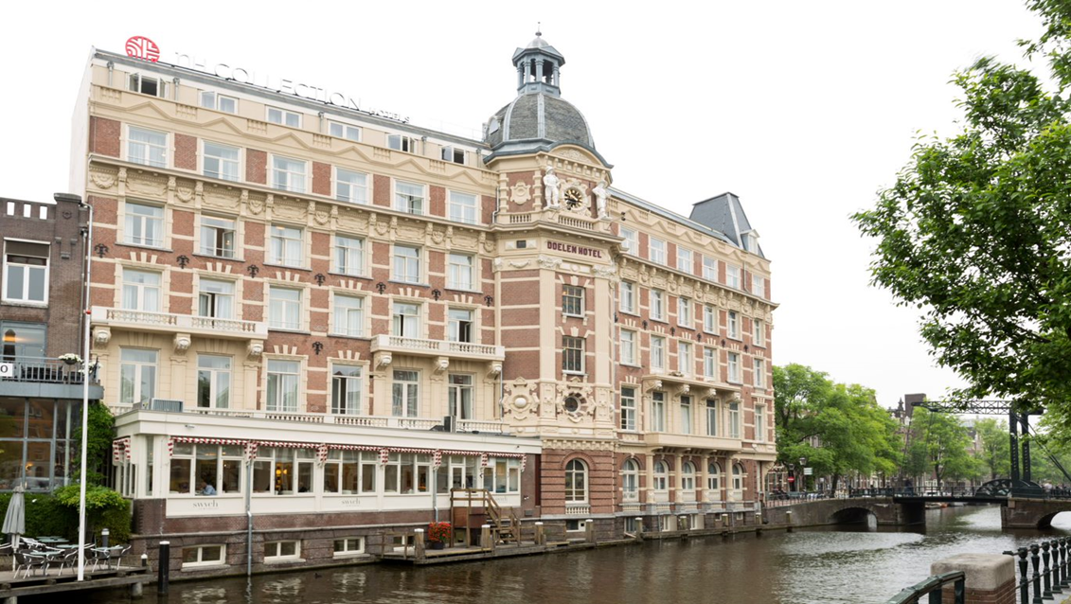

AGENDA
Minor Company Profile
ASEAN
Thailand
Trade

Slide 3
COMPANY PROFILE

Slide 4














































Who are we
Statements included or incorporated in these materials that use the words "believe", "anticipate", "estimate", "target", or "hope", or that otherwise relate to objectives, strategies, plans, intentions, beliefs or expectations or that have been constructed as statements as to future performance or events, are "forward-looking statements" within the meaning are not guarantees of future performance and involve risks and uncertainties that could cause actual results to differ materially from historical results or those anticipated at the time the forward-looking statements are made. MINT undertakes no obligation to publicly update or revise any forward-looking statement, whether as a result of new information, future events or otherwise. MINT makes no representation whatsoever about the opinion or statements of any analyst or other third party. MINT does not monitor or control the content of third party opinions or statements and does not endorse or accept any responsibility for the content or the use of any such opinion or statement.

Slide 5
















MINT’s Key Milestones
Overview
Increased stake to 100% in
Increased stake to 31% in
Acquired
in Australia
Acquired additional stake from
in hotels in Africa
50% stake in
Launched
Joint venture with
in African Assets
94.1% stake in
Increased stake to 100% in
Launched
70% stake in
Launched
49% investment in hotel & mixed use project in Maputo, Mozambique
Acquired remaining 7 hotels & brand
Founded
Founded
Launched
50% stake in
100% stake in
75% stake in
1978 | 1980 | 1982 | 1988-9 | 2000-1 | 2003 | 2008 | 2009 | 2010-11 | 2012-13 | 2014 | 2015 | 2016 | 2017 | 2018
Founded
RGR, MFG and MINOR listed
M&A of
RGR and MFG and became
Completed group business restructuring; Delisted
49% stake in
Acquired 7 hotels
Acquired 74% stake in
Invested in
11% stake in
Increased stake to 69.2% in
Acquired additional 20% stake in

Slide 6

MINT – Today
Overview
Minor Hotels
Minor Food
Hotel
Equity-Owned
Hotel and Serviced Suites Management
Spa
Mixed-Use
Plaza & Entertainment
Residential Development
Point-Based Vacation Club
Casual Dining Restaurants
Equity-Owned
Franchised
Manufacturing
Cheese & Ice-cream
Ice-cream Ingredients and Toppings
Coffee Roasting
Shared Services

Slide 7
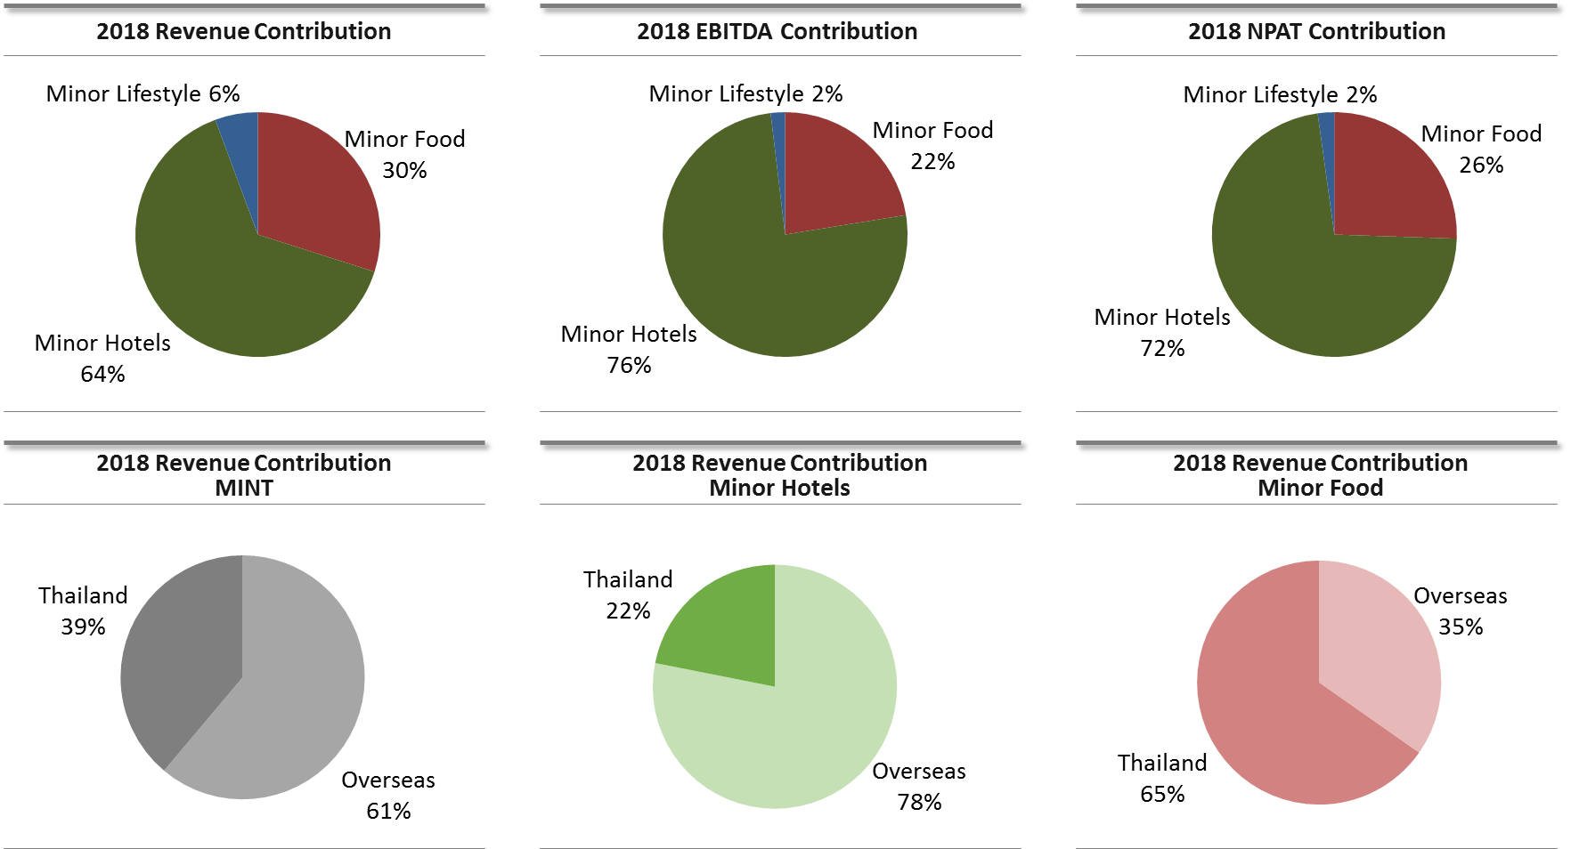
MINT – Contributions by Business Groups & Geographies
Overview
*Core operations, excluding non-recurring items

Slide 8
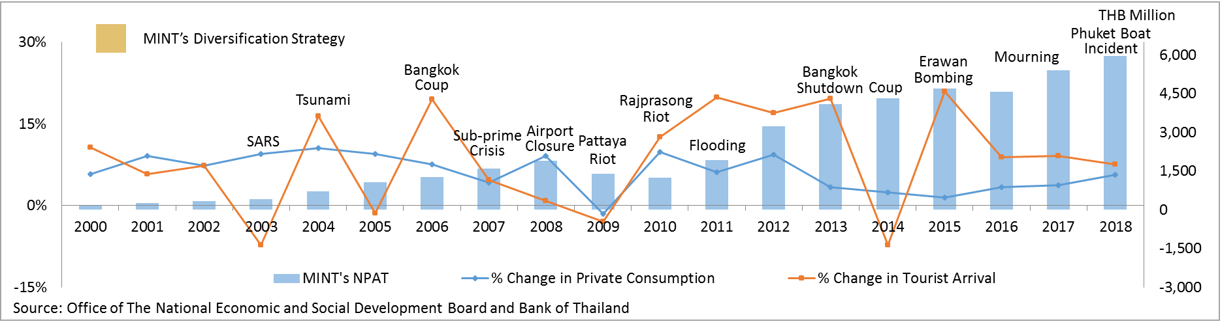
Resiliency of Thailand vs. MINT’s Responsive Strategies
Financial Highlights
Since 2000, Thailand has gone through several challenges, driven by both domestic and global factors. Geographical diversification and new initiatives including mixed-use development have proven to mitigate the risks, with MINT reporting profit all along.
2000 – 2005
Acquired Minor Food Group
Launched own Pizza brand, The Pizza Company and opened TPC and SZ in China
Launched own hotel brand, Anantara
Entered into a JV to operate 3 hotels in the Maldives
Launched the first timeshare project in Asia with Marriott
2006 – 2009
Acquired Minor Corporation
Invested in S&P Thailand, The Coffee Club Australia and Thai Express Singapore
Entered into a JV with Serendib Sri Lanka and Elewana Africa
Launched the first residential project, the Estates Samui
Opened the first two overseas purely managed hotels in Bali and Abu Dhabi
2010 – 2018
Invested in Beijing Riverside & Courtyard China, VGC in Australia, Corbin & King in the UK and non-US operations of Benihana
Invested in hotels in Sri Lanka, Phuket, Vietnam, Cambodia, Zambia, Namibia, Botswana, Lesotho and Mozambique, in Oaks Hotels & Resorts in Australia, in Tivoli Hotels & Resorts in Portugal and Brazil and in NH Hotel Group in Spain
Launched AVANI brand, Anantara Vacation Club, and the new residential projects, Layan Residences by Anantara, Avadina Hills by Anantara and Anantara Chiang Mai Serviced Suites

Slide 9
MINT’s Presence
Overview
Enhance profile, reputation & recognition with 513 hotels and serviced suites, 2,270 restaurant outlets and 61 spas. With the recent investment in NH Hotel Group, MINT has expanded its operations to a total of 62 countries.
The Americas
Canada
USA
Argentina
Brazil
Chile
Colombia
Cuba
Dominican Republic
Ecuador
Haiti
Mexico
Uruguay
Europe
Austria
Belgium
Czech Republic
France
Germany
Hungary
Italy
Luxemburg
Poland
Portugal
Romania
Slovakia
Spain
Switzerland
The Netherlands
UK
Asia Pacific
Australia
Cambodia
China
India
Indonesia
Korea
Laos
Malaysia
Maldives
Myanmar
New Zealand
Pakistan
Singapore
Sri Lanka
Thailand
Vietnam
Africa
Botswana
Egypt
Kenya
Lesotho
Mozambique
Namibia
Seychelles
Tanzania
South Africa
Zambia
Middle East
Bahrain | Oman
Jordan | Qatar
Kuwait | Saudi Arabia
Lebanon | UAE
Minor Hotels
Minor Food
Minor Lifestyle

Slide 10
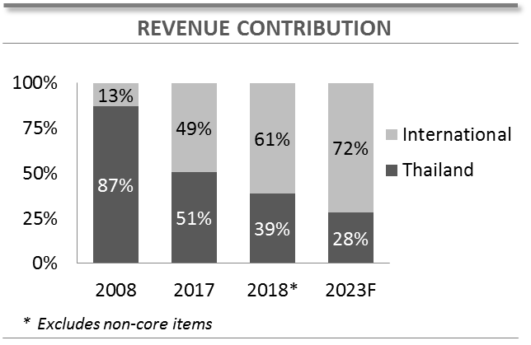
International Presence
With solid diversification strategy, MINT’s footprint was in 62 countries at the end of 2018 across its hospitality and restaurant businesses.
Minor Hotels
Minor Food
Combination
Notes:
After the acquisition of NH Hotel Group, we are now in 62 countries across the globe.
Correspondingly, our revenue contribution from overseas has been increasing.
We had the newly roll-over 5-year plan, which was endorsed by the board in November of last year.
According to the new 5-year plan, by 2023, we expect the overseas contribution to be almost three-fourths of total revenue.

Slide 11
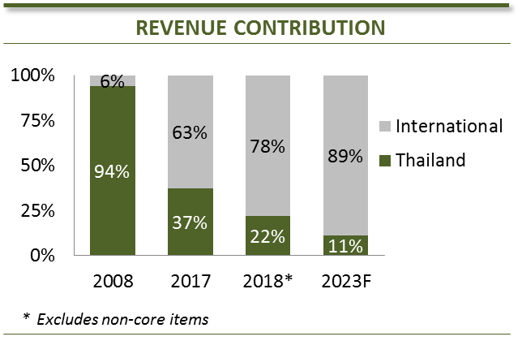







Minor Hotels – International Presence
In recent years, MINT has implemented a solid diversification strategy. With the investment in NHH, MINT operates hotels and spas under a combination of investment, joint-venture and management business models in 53 countries.
Investment
Management
Combination
New Destinations in Pipeline
Hubs
Notes:
With our diversification strategy, Minor Hotels today is in 53 countries, and our revenue contribution has rapidly been shifted to overseas, with 78% of our revenues coming from overseas in 2018.
The overseas contribution will continue to grow and is expected to be almost 90% of Minor Hotels’ total revenue by 2023.
It is important to note that although contribution from Thailand will decline further in 2019 with the full consolidation of NH this year, we still expect Thailand to be one-third of our net profit this year, and another one-third coming from Europe.

Slide 12
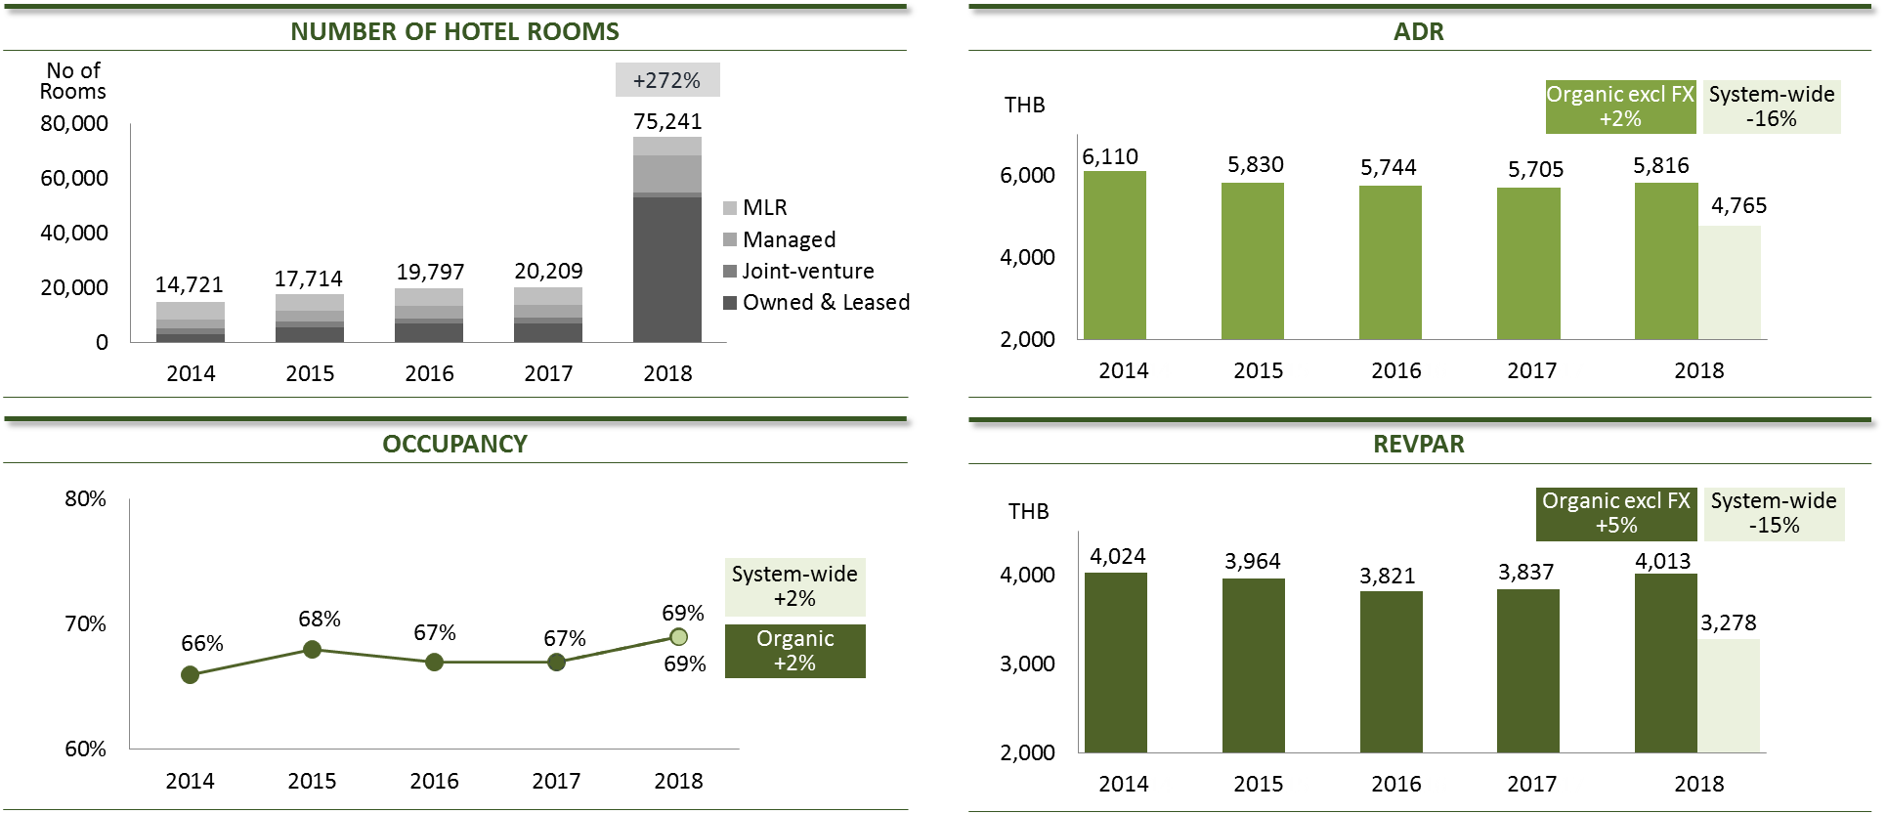
System-wide Hotel Portfolio
Excluding new hotels and FX impact, organic RevPar of the entire portfolio increased by 5% in 2018, driven primarily by owned and joint-venture hotels portfolio. 2018 system-wide RevPar declined by 15%, primarily from the change in room type mix with the consolidation of the NHH portfolio.
Notes:
For our system-wide portfolio, the number of rooms has more than tripled in 2018, and we now have over 75,000 rooms in our portfolio, of course that’s mostly from the NH portfolio.
The consolidation of NH has moved us up the rank to be within the top 20 hotels in the world in terms of number of rooms.
Organic RevPar excluding FX increased by 5%, from owned and joint-venture hotel, and from both occupancy and rate increase.
Including new hotels and NH portfolio, system-wide RevPar declined by 15%, primarily from the change in the mix of our room types with the consolidation of NH portfolio.

Slide 13

Hotel Expansion Pipeline
2019F
2020F
2021F
2022F
  Desaru, Malaysia 103 rms
  Ubud, Bali, Indonesia* 71 rms
  Antwerp, Belgium 180 rms
  Paseo de Montejo, Mexico 120 rms
  Mannheim, Germany 225 rms
  Leipzig, Germany 197 rms
  Warangi, Serengeti
  National Park, Tanzania* 12 rms
  Fares Island, Maldives* 200 rms
  Milan, Italy 185 rms
  Santander, Spain 64 rms
  Monterey La Esfera, Mexico 120 rms
  Cancun, Mexico 140 rms
  Milan, Italy 100 rms
  Hannover, Germany 89 rms
  Amsterdam, Netherlands 650 rms
  Khao Lak, Thailand 328 rms
  Frankfurt, Germany 428 rms
  Hamburg, Germany 261 rms
  Frankfurt, Germany 375 rms
HOTEL INVESTMENT
7 Hotels / 908 Rooms
8 Hotels / 1,548 Rooms
4 Hotels / 1,392 Rooms
19 Hotels / 3,848 Rooms
* Note: Joint-ventured properties
  Bahia, Brazil 50 rms
  Le Chaland, Mauritius 164 rms
  Tozeur, Tunisia 93 rms
  Victoria, Australia 170 rms
  Angkor, Cambodia 80 rms
  Seminyak, Bali, Indonesia 37 rms
  Busan, Korea 289 rms & 570 rms
  Bangkok, Thailand 382 rms
  Tunis, Tunisia 41 rms
  Dubai, UAE 372 rms
  Vũng Tàu, Vietnam 149 rms
  Recife, Brazil 200 rms
  Brasilia, Brazil 395 rms
  South Australia, Australia 278 rms
  Hangzhou, China 132 rms
  Busan, Korea 436 rms
  Beirut, Lebanon 110 rms
  Wellington, New Zealand 226 rms
  Khon Kaen, Thailand 79 rms
  Santiago, Chile 86 rms
  Valencia, Spain 47 rms
  Bahia, Brazil 207 rms
  Porto, Portugal 79 rms
  Lima, Peru 265 rms
  London, UK 190 rms
  Laikipia, Kenya 7 rms
  Libo Country, China 173 rms
  Phi Phi Island, Thailand 107 rms
  Ras Al Khaimah, UAE 140 rms
  Dubai, UAE 528 rms
  Ras Al Khaimah, UAE 225 rms
  Hangzhou, China 166 rms
  Queensland, Australia 50 rms
  Daegu, Korea 144 rms
  Venice, Italy 150 rms
  Iquique, Chile 135 rms
  Mexico City, Mexico 144 rms
  Lima, Peru 164 rms
  Santiago, Chile 146 rms
  Chengdu, China 150 rms
  Nanjing, China 120 rms
  Zhuhai, China 160 rms
  Accra, Ghana 155 rms
  Sharjah, UAE 233 rms
  Zhuhai, China 300 rms
  Savanne, Mauritius 156 rms
  Muscat, Oman 150 rms
  Gammarth, Tunisia 232 rms
  Dubai, UAE 528 rms
  Cam Ranh, Vietnam 595 rms
  Fortaleza, Brazil 130 rms
  Phuket, Thailand 500 rms
  Zhuhai, China 100 rms
  Hangzhou, China 54 rms
  Sifah, Oman 198 rms
  Kota Kinabalu, Malaysia 386 rms
  Ho Chi Minh City, Vietnam 217 rms
  Guadalajara, Mexico 120 rms
  Panama 83 rms
MANAGEMENT CONTRACTS / MLRS
  Others
27 Hotels / 5,134 Rooms
13 Hotels / 2,272 Rooms
15 Hotels / 3,563 Rooms
5 Hotels / 1,004 Rooms
60 Hotels / 11,973 Rooms
Notes:
We continue to build our hotel pipeline through both our own investments and management contracts.
We are investing in almost 20 hotels with almost 4,000 rooms over the next 4 years. The number also includes NH’s existing expansion plans.
On the hotel management side, we are looking at opening another 60 hotels with almost 12,000 rooms.
We are expanding across our various brands in both existing and new geographies.
The list is the minimum pipeline that we have already committed. And we continue to look for further expansion as we speak.
To summarize on our 2019 outlook of the hotel business,
We are very confident in the 2019 performance
Owned hotels will be driven by recovery of Thailand, full benefit of Portugal renovations, and also the Maldives as we turn to focus on rate increase this year.
NH will continue to see strong performance, both from top line growth and their continued drive for efficiency. We will also see the full-year consolidation of NH this year.
And lastly, we will continue to build on our expansion pipeline.

Slide 14
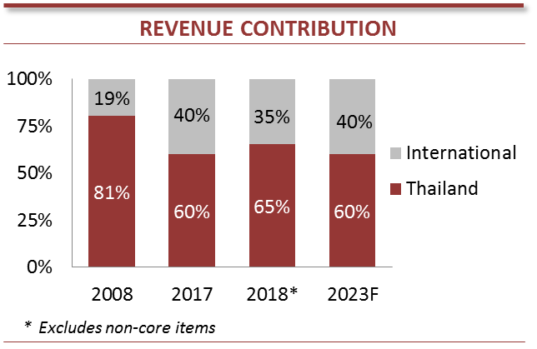





Minor Food – International Presence
MINT operates three restaurant hubs: Thailand, China and Australia. MINT’s restaurant presence is now in 27 countries across the region, operating owned, franchised and a combination of both business models. MINT continues to look for opportunities to expand, especially in these existing markets.
Owned
Franchised
Combination
Hubs
Notes:
Minor Food has expanded its footprint to cover 27 countries today, with the acquisition of Benihana in April of this year.
We operate in 3 hubs, Thailand, China and Australia. We have taken out Singapore from the presentation as the operation has become smaller since our downsizing.
We have paused our expansion in Singapore for the time being and shift our focus to markets with more promising outlook.
Today, Thailand contributes 65% of Minor Food’s revenue, and is expected to decline to 60% over the next five years, as we grow our China and Australia operations and other developing markets.

Slide 15
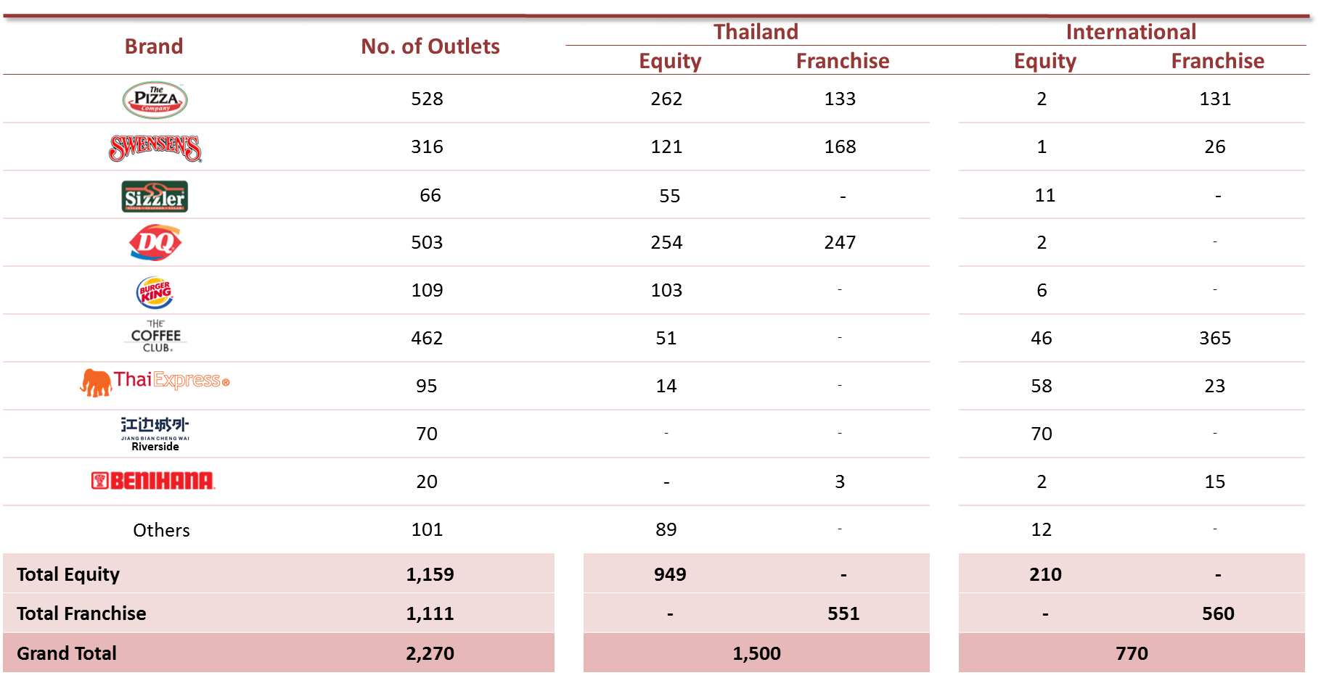
Minor Food Portfolio
Minor Food

Slide 16
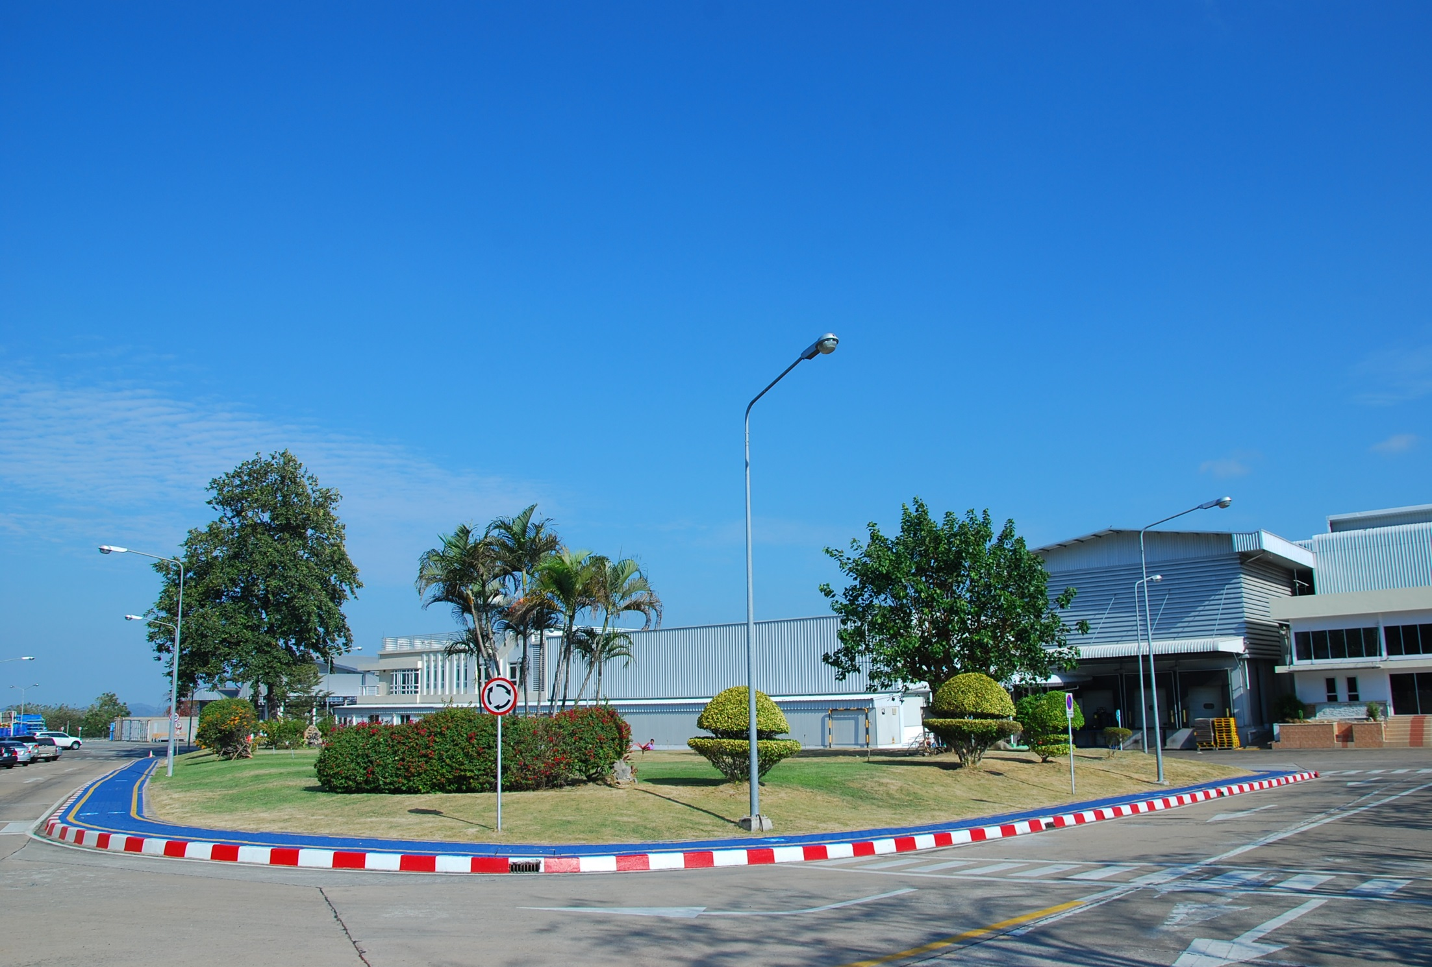
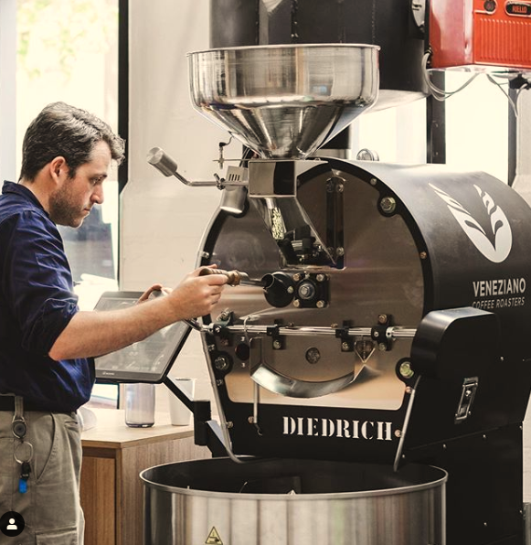







Manufacturing
Minor Food
Two manufacturing plants in Thailand producing over 20,000 tons of cheese and ice cream per annum
Coffee roasting factory in Australia
Manufacturing of ice-cream ingredients and toppings

Slide 17













Minor Lifestyle Portfolio
Minor Lifestyle
Fashion
# Outlets
# Outlets
119
27
82
9
83
9
40
6
32
2
Total 409
Household
Lifestyle
# Outlets
Scomadi
31
29
Contract Manufacturing
21
-
Manufacturing of acid-based
fast-moving consumer goods
Total 81
100K Tons / Year

Slide 18
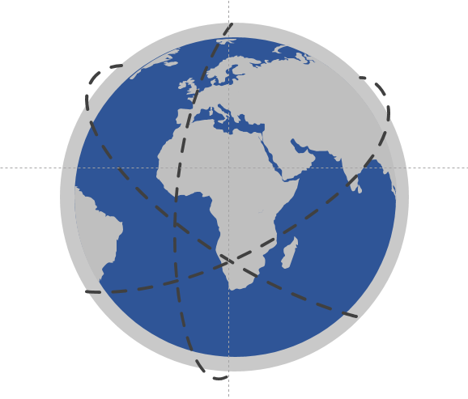


MINT’s Five-Year Strategy
Revenue Growth
> 10% CAGR
NPAT Growth 15-20%
ROIC = 12%
2023 Goals
Employer of Choice
Sustainable Business
Winning Brand Portfolio
Value Capture & Productivity
Investments, Partnerships & Acquisitions
Innovation & Digital
Empowered People & Team
Sustainable Framework
Brands & value chains monetization
1
Ensure commitment
Superior workforce
Sustainable leadership
Good Corporate Governance
Growth Pillars
Margin enhancement
through integration & shared operations
2
Set clear targets
People
Customers
Leverage ecosystem partners
3
Partners
Environment
Capital optimization with asset right strategy & mixed-use business
Engaging work environment
4
Promote digital culture
Social Responsibility Mindset
Notes:
Lastly, I would like to update on our new five-year plan:
For our 2023 goals:
We maintained our financial goals, where we would like to see revenue growth of over 10% and net profit growth of 15-20% over the next 5 years and target ROIC of 12% by 2023.
In addition to our financial goals, we added 2 non-financial ones.
As we are in the service industry, people are our greatest assets. So, we want to be the employer of choice in order to attract and maintain high quality people.
We also aim to operate a sustainable business for our long term growth.
In order to achieve these goals, we have 6 pillars which are our drivers:
We will maintain a winning brand portfolio. We will build on our established brands, develop the ramping up brands, and divest some of the brands that do not yield expected returns.
We will look for opportunities for value capture and productivity. This includes:
Potential revenue growth through maximizing the full potential of our brands, such as rebranding exercise
Enhance margins, including through improved operations and sharing of resources
Optimize capital use with asset right growth.
We will continue to focus on partnerships and investments, whether it’s for expanding our footprint or for disruptive innovation.
And of course, with today’s rapidly changing world, we also need to focus on innovations and digital
We have to have our empowered people and teams in order to remain a high performance and customer-centric organization
For sustainability, we continue to focus on people, customers, partners and environment, while maintain good corporate governance and instill social responsibility mindset in our people.
With this 5 year plan in place, I am sure of our growth going forward.

Slide 19
Five-Year Aspiration
2023F
2023
> 630 hotels
> 250 residences built
> 500 vacation club units
> 4,400 restaurants
> 600 retail shops & POS (>46,000 sq.m.)
2018
513 hotels
132 residences built to date
229 vacation club units
2,270 restaurants
490 retail shops & POS (31,776 sq.m.)
2018
REVENUE THB 78.5 bn
2013
REVENUE THB 36.9 bn
2009
30 hotels
1,112 restaurants
292 retail shops & POS (14,275 sq.m.)
Notes:
To summarize, in 5 years time, we would like to see:
over 630 hotels,
over 250 residences built,
over 500 vacation club units,
over 4,400 restaurants, and
over 600 retail shops and points of sales
With this, I would like to end my presentation, and take any questions from the floor.

Slide 20






Governance and Risk
Stronger
Unchanged
Slower
Disruption
Regulation
Behaviour
Opportunities
Business Interruption
- Physical
- Supply Chain
- Internet Reliance
- Cyber
New Technology
Political Risk
Market Share
Startups
Statutory Reporting
Legislation Changes
- Tax
- Labour
- Fire, Life, Safety
Currency
Commodities
Interest Rates / Inflation
Trade
Reputation / Brand
Climate Changes
Privacy & Greater Availability of Data
Blind Spots
Social Conscious Consumers & Activism
Fraud
Risk as a performance Enable
Anticipate & Response to Emerging Threats
Risk Dashboards & Scenario Analysis
Automated Compliance Monitoring
Business Continuity Plans
Risk Appetite in Project Evaluation

Slide 21
What is the trade risk
Economic risks
Risk of concession in economic control
Risk of insolvency of the buyer
Risk of non-acceptance
Risk of protracted default i.e. the failure of the buyer to pay off the due amount after six months of the due date
Risk of Exchange rate
Political risks
Risk of non- renewal of import and exports licenses
Risks due to war
Risk of the imposition of an import ban after the delivery of the goods
Surrendering of political sovereignty
Buyer Country risks
Changes in the policies of the government
Exchange control regulations
Lack of foreign currency
Trade embargoes
Commercial risk
A bank's lack of ability to honor its responsibilities
A buyer's failure pertaining to payment due to financial limitations
A seller's inability to provide the required quantity or quality of goods
Others Risks
Cultural differences e.g., some cultures consider the payment of an incentive to help trading is absolutely lawful
Lack of knowledge of overseas markets
Language barriers
Inclination to corrupt business associates
Legal protection for breach of contract or non-payment is low
Effects of unpredictable business environment and fluctuating exchange rates
Sovereign risk - the ability of the government of a country to pay off its debts

Slide 22
ASEAN

Slide 23

ASEAN
Austcham ASEAN

Slide 24
WHY ASEAN Snapshot
ASEAN was established was in 1967
The Chairmanship of ASEAN rotates annually, 2019 will be hosted by Thailand and 2020 by Vietnam
ASEAN Is the 5th largest economy in the world and 2nd largest Foreign Direct Investment (FDI) recipient
Over the last 15 years ASEANs combined economy has quadrupled to US $2.5 Trillion
660+ million people with a young working age population and rising middle class
Notes:
Australia’s $93 billion two way trade with ASEAN has grown by over $25 billion in the past decade and now exceeds our trade with the US and Japan. ASEAN accounts for 11.5 per cent of Australia’s exports and 16.1 per cent of imports. ASEAN was the largest source of goods export revenue for Australia’s SME exporters in 2014/15.

Slide 25











AustCham ASEAN was lacunhed in June 2017 and is a “Chamber of Chambers” representing over 2,000 Australian corporate members.
Brunei
Pending
Cambodia
Australian Chamber of Commerce, Cambodia (AusCham Cambodia)
Indonesia
Australia Indonesia Business Council (IABC)
Lao PDR
The Australia Chamber of Commerce Lao PDR (AustCham Laos)
Malaysia
Malaysia-Australia Business Council (MABC)
Myanmar
Australian Chamber of Commerce Myanmar Association
Philippines
The Australian-New Zealand Chamber of Commerce (Philippines) Inc (ANZCHAM Philippines)
Singapore
Australian Chamber of Commerce, Singapore (AustCham Singapore)
Thailand
Australian-Thai Chamber of Commerce (AustCham Thailand)
Vietnam
The Australian Chamber of Commerce in Vietnam (AusCham Vietnam)
Notes:
Our nine foundation members

Slide 26
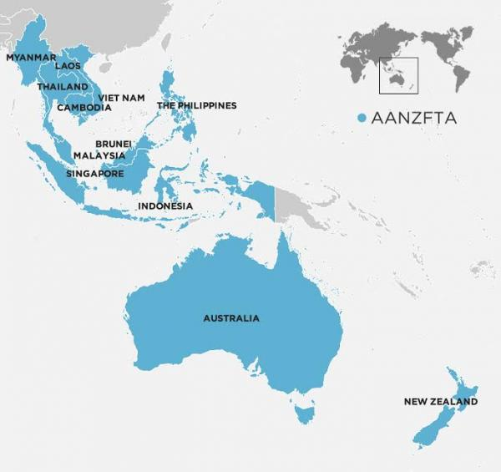
ASEAN- Australia trade relationship
Australia’s $93 billion two way trade with ASEAN has grown by over $25 billion in the last decade and now exceeds our trade with US and Japan
Top three trading partner - ASEAN accounts for 11.5 per cent of Australia’s exports and 16.1 percent of imports.
ASEAN currently accounts for about 14% of Australia’s total trade
Notes:
Australia’s $93 billion two way trade with ASEAN has grown by over $25 billion in the past decade and now exceeds our trade with the US and Japan. ASEAN accounts for 11.5 per cent of Australia’s exports and 16.1 per cent of imports. ASEAN was the largest source of goods export revenue for Australia’s SME exporters in 2014/15.
Australia and ASEAN have a strong trade and investment relationship and our FTA’s give us a competitive edge

Slide 27
ASEAN-Australia Free Trade Agreements
ASEAN Australia New Zealand Free Trade Agreement (AANZFTA)
Malaysia Australia Free Trade Agreement (MAFTA)
Thailand Australia Free Trade Agreement (TAFTA)
Indonesia Australia Comprehensive Economic Partnership (IA-CEPA)
Singapore Australia Free Trade Agreement (SAFTA) and Singapore Australia Comprehensive Strategic Partnership (CSP)
Notes:
Australia and ASEAN have a strong trade and investment relationship and our FTA’s give us a competitive edge
Australia has FTA’s with Malaysia, Thailand and Singapore, IA-CEPA (Indonesia) signed by not yet in force.
RCEP is ASEAN plus 6 (Australia, China, India, Japan, Korea and NZ).
CP TPP (includes Australia, Brunei, Malaysia, Singapore, Vietnam and NZ – plus Canada, Chile, Japan, Mexico, Peru)

Slide 28
ASEAN integration is viewed as important for market access, and number of areas to accelerate progress
Notes:
Access to markets continues to be cited by two-thirds of firms as the major benefit from ASEAN integration. Investment or service restrictions continue to be the main priority for acceleration for Australian business, identified by almost half (47%) of respondents. Reducing infrastructure gaps (41%), and improving labour mobility (39%) continue to be other key priorities of the Australian business community in ASEAN.

Slide 29
Utilisation of the AANZFTA is increasing from a low base, but knowledge gaps remain a hurdle
Notes:
The ASEAN-Australia-New Zealand Free Trade Agreement (AANZFTA) was the most utilised trade agreement in the region. However only 18% were utilising the agreement, with 6% utilising it significantly. It was also the most well-known agreement, despite more than one-third (35%) of respondents being unaware of this agreement.
One-third (33%) of respondents had no issues with the ASEAN-Australia-New Zealand Free Trade Agreement. However, 35% felt they lacked the information they needed to effectively take advantage of the agreement. Only 20% of respondents didn’t feel that the agreement was relevant for their business.

Slide 30
THAILAND

Slide 31

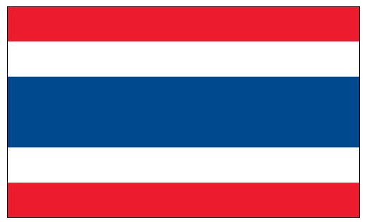
THAILAND
Thailand ranks as one of the easiest countries in the South East Asian region in which to do business; it is Australia’s sixth largest two-way goods and services trading partner - and second largest in ASEAN - with two-way trade in excess of $14 billion a year, and Australian investment backed by the Thailand-Australia Free Trade Agreement.
Thailand is a regional and global manufacturing hub for vehicles, automotive components, consumer electronics, and processed food and beverages. It is also a leading exporter of agricultural commodities. Thailand is also a significant international tourist destination with around 35 million visitors in 2017.
The government of Thailand has announced a “Thailand 4.0” development plan to encourage investment into a value-based, digital, innovation-driven and services-based economy, especially within the ten targeted industries including: automotive, electronics, high-value tourism and medical tourism, efficient agriculture, food innovation, automation and robotics, aerospace, bio-energy and bio-chemicals, digital medical and healthcare
Title AECONOMIC INDICATORS | 2013 | 2018
GDP (US$B) (CURRENT PRICES) | 420.3 | 490.1
GDP PER CAPITA (US$) | 6,154.5 | 7,084.5
REAL GDP GROWTH (% CHANGE YOY) | 2.7 | 4.6
PRINCIPAL EXPORT DESTINATIONS 2017
1. CHINA | 12.5%
2. UNITED STATES | 11.2%
3. JAPAN | 9.4%
6. AUSTRALIA | 4.4%
PRINCIPAL IMPORT SOURCES 2017
1. CHINA | 19.9%
2. JAPAN | 14.4%
3. UNITED STATES | 6.7%
14. AUSTRALIA | 2.0%

Slide 32
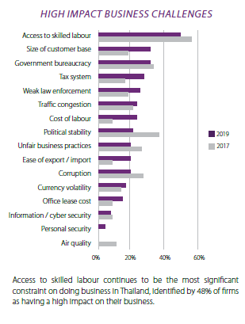
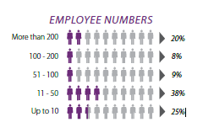
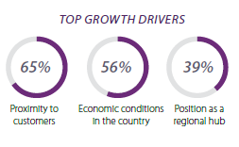
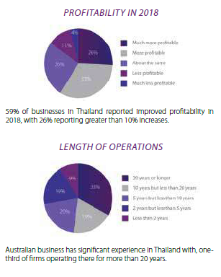
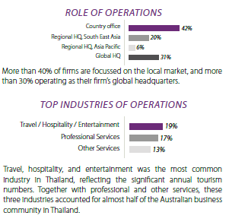
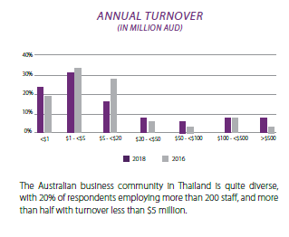

Slide 33
Access to skilled labour continues to be the greatest constraint to operating in Thailand
Notes:
Access to skilled labour continues to be the most significant constraint on doing business in Thailand, identified by 48% of firms as having a high impact on their business.

Slide 34
TRADE

Slide 35
Thailand-Australia FTA
The Thailand-Australia Free Trade Agreement (TAFTA) is one of two FTAs that Australian businesses can use to trade with Thailand. As a member of ASEAN, Thailand is also part of the ASEAN-Australia-New Zealand Free Trade Agreement (AANZFTA) .
TAFTA has eliminated the majority of Thai tariffs on goods imported from Australia. The reduction of Thailand's previously high tariff barriers (for some goods, up to 200 per cent) is a significant win for Australian businesses, opening up a range of export opportunities in Southeast Asia's second-largest economy. TAFTA also improves the environment for bilateral services trade and investment. The agreement entered into force on 1 January 2005 and was Australia’s third free trade agreement. It was Thailand’s first comprehensive free trade agreement and its first with a developed country. Total two-way trade between Australia and Thailand has more than doubled since TAFTA entered into force.
Increased access for Australian investors in Thailand, permitting majority Australian ownership for businesses in certain sectors including mining operations, construction services, restaurants and hotels, tertiary education institutions, maritime cargo services and more.
More open access for Australian companies to Thailand’s services market and a commitment to liberalise two-way services trade in future.
Provisions on investment protection that guarantee a range of rights to Australian direct investors in Thailand, including the right to transfer their funds out of Thailand at any time, and the right to seek impartial resolution of any disputes with the Thai government over their investments.
The elimination of 94 per cent of Thailand’s tariff and quota barriers on imports from Australia as of 2010, with the remaining tariffs phasing to zero in 2015 or 2020 (with the exception of skim milk powder and liquid milk and cream, for which the tariff rate quotas will be eliminated in 2025).
Facilitates business by easing visa and other requirements for the temporary entry of Australian business people to Thailand, including through reduced paperwork, access to a one-stop visa and work permit service, and extension of the maximum length of stay under business visa arrangements.
Key interests and benefits

Slide 36
TAFTA in a nutshell
AFTA (Thailand) Thailand had relatively high tariff rates, with few duty free tariff lines and some relatively high tariff peaks. For example, automotive tariffs were up to 80 per cent, while beef tariffs were 51 per cent. Around half of Thailand’s tariffs on complying Australian imports were reduced to zero upon entry into force in 2005.
A substantial proportion of remaining tariffs were phased to zero by 1 January 2010, with most remaining tariffs to be phased to zero by 1 January 2015. Border restrictions on some agricultural products such as beef will not be phased out until 2020, while designated dairy tariff quotas will not be abolished until 2025. Australia will reduce all tariffs on imports from Thailand to zero by 2015. Under the agreement, tariffs on motor vehicles were cut to zero upon its entry into force.
Some thoughts
Are the benefits really delivered
FTAs can have a ‘head turning’ effect on trade, ie. customers in FTA partner markets such as Thailand now look at opportunities for supply from Australia ahead of other suppliers as they see the commercial advantage of setting up long term business relationships linked with FTA preferences.
However are these FTA’s fit for purpose??
  The reality is that most business we as a chamber come across are mid-sized businesses, or larger companies (eg hotels, hospitality, consultancies etc) which deal in services and not necessarily just exporters.
Thailand reduced tariffs, but in sensitive areas (eg Auto’s and Wine) competitive advantage that was given to Australian exporters to Thailand in this area was whittled away by increases in excise taxes.
Given that agricultural products from Australia are set to be liberalized under TAFTA schedules in the next few years (beef, dairy) will we see the same thing happen as Thailand seeks to protect industry that has had 14 years to ‘prepare’ and ‘adjust’ for this moment, either via new excise taxes or new non-tarriff barriers such as agricultural and quarantine rules.
Outreach and support from Australian government and industry necessary to minimize the chances of this occurring
Some thoughts
Are the benefits really deiivered
General Pros and cons of FTA’s
General Pros and cons of FTA’s
Well known that gains from trade are greatest if barriers are removed multilaterally via global trade deals
Are bilateral free trade agreements then ‘building blocks’ that are making genuine progress in reducing trade barriers, more rapidly and deeply than could be achieved through multilateral means alone? Or are they ‘stumbling blocks’ that distort trade patterns and have the effect of undermining multilateral trade negotiations and impeding domestic reform?

Slide 37

Some of the key findings of the 2009 Australian Productivity Commission report into Australia’s FTA’s include
Businesses have provided little evidence that Australia’s BRTAs (Bilateral and Regional Trade Agreements) have generated significant commercial benefits. The information available suggests that, where benefits accrue, they are mainly to existing exporters
The evidence available to the Commission indicates that the direct economic impacts from services and investment provisions in Australia’s BRTAs to date have been modest. More significant gains may be achieved in the future through some of the processes established under Australia’s agreements. However, their realisation will require concerted efforts from Australia and its BRTA partners over many years.
https://www.pc.gov.au/inquiries/completed/trade-agreements/report/trade-agreements-report.pdf

Slide 38
PROVIDING VALUE TO
THE BUSINESS

Slide 39

INFLUENCE and IMPACT

Slide 40
THANK YOU

